Slide 1
What’s in a Rose? Glazing the Rose Windows of Chartres Cathedral
Detail, north transept rose, Chartres Cathedral, c. 1235
Dr. Elizabeth Carson Pastan, Emory University
Friends of Chartres, 19 September 2024

Slide 2
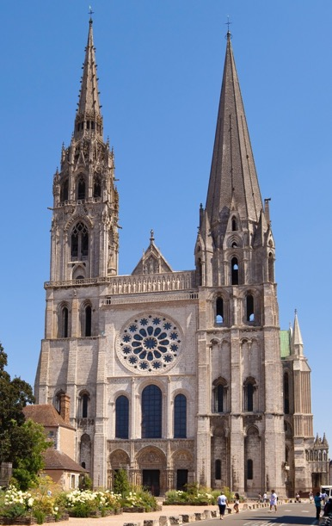
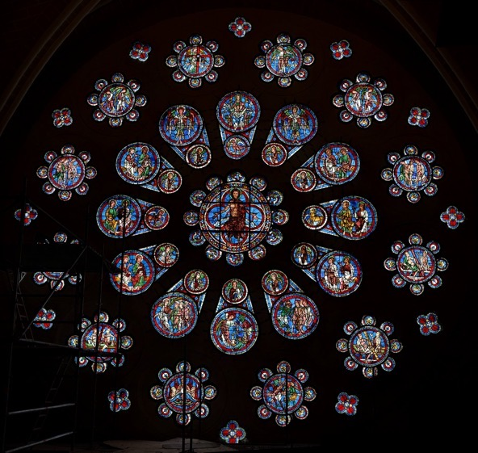
The cathedral of Notre-Dame of Chartres and its western rose window, c. 1205-10

Slide 3
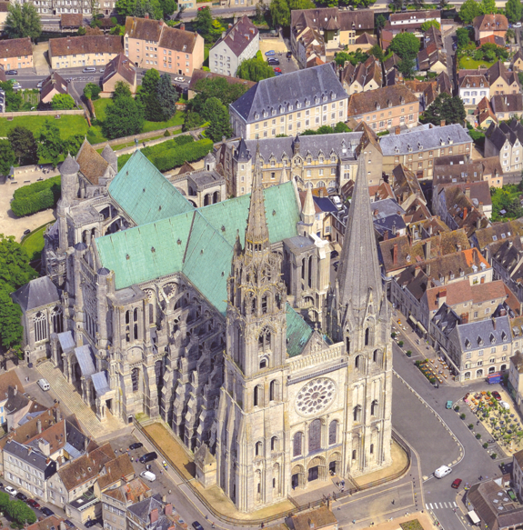
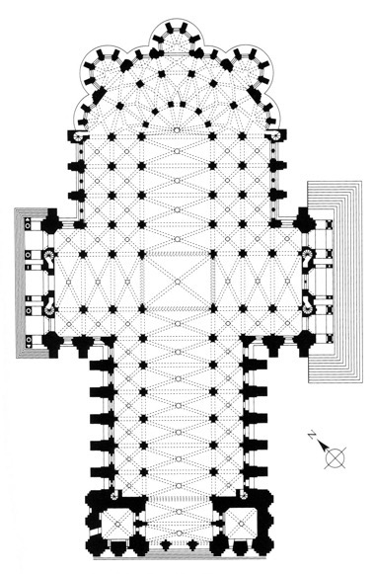
What a rose window does: 3) highlights the cross shape of the building
View and plan of Chartres Cathedral, with its 3 rose windows indicated

Slide 4
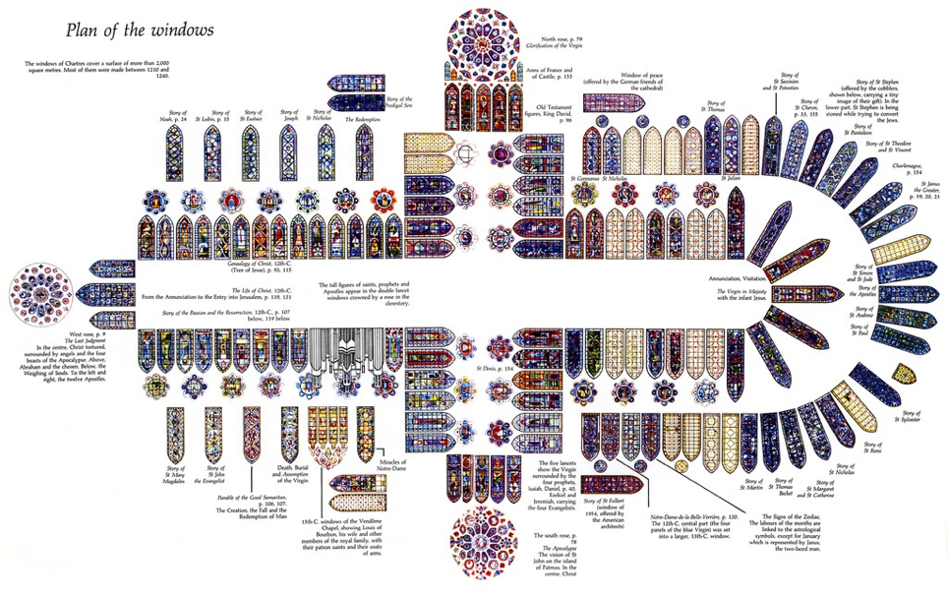
N
Chartres Cathedral

Slide 5
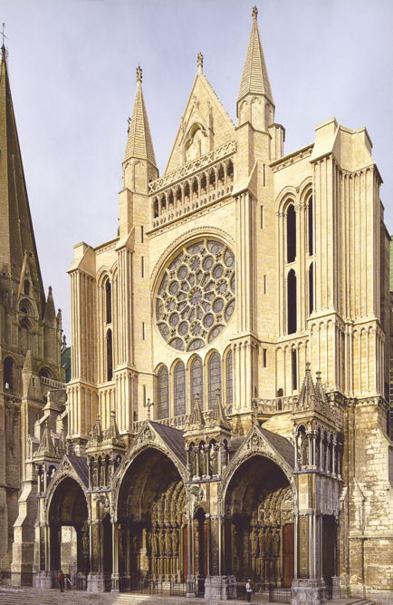
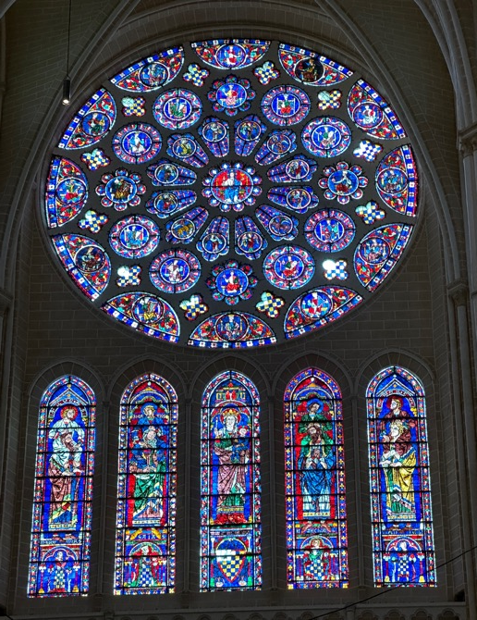
Chartres, interior of the south transept rose, c. 1235
Chartres, exterior view of the south transept rose

Slide 6
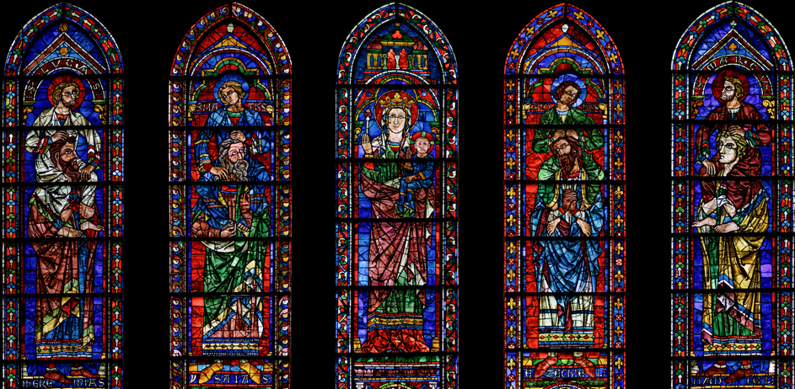
Chartres Cathedral, detail of the lancets beneath of south transept rose window, showing the Christian evangelists ’born on the shoulders of giants’: Jeremiah, Isaiah, Ezekiel and Daniel

Slide 7
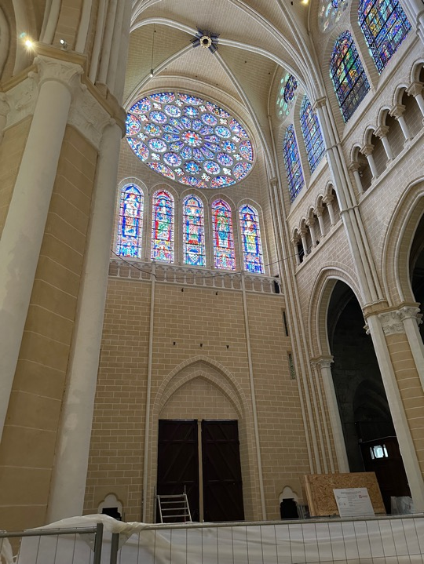
I-phone photo of Chartres’s newly restored south transept arm, summer 2023

Slide 8
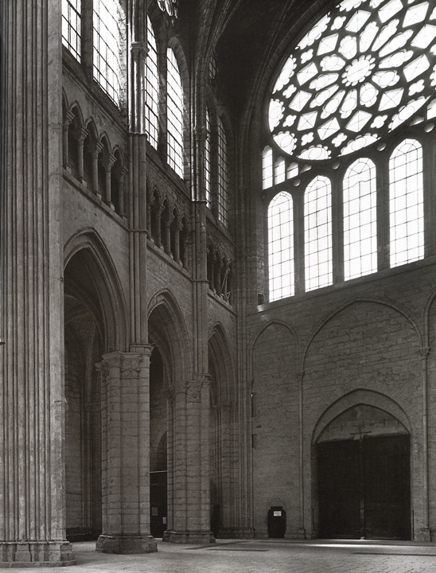
View of Chartres Cathedral’s northern rose window of c. 1235, taken in the 1940s when the medieval stained glass had been removed for safety

Slide 9
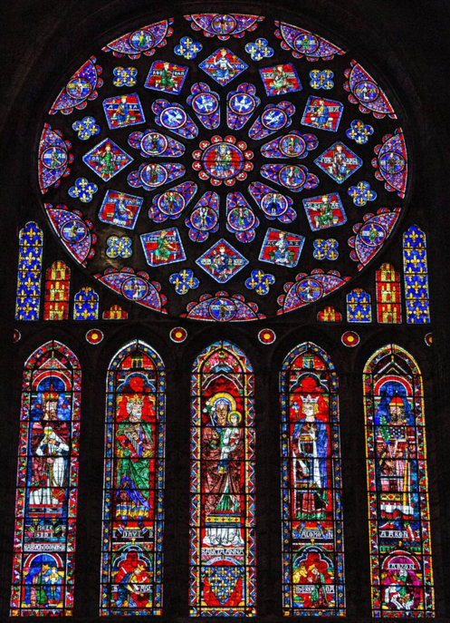
Chartres Cathedral, northern rose, c. 1235

Slide 10
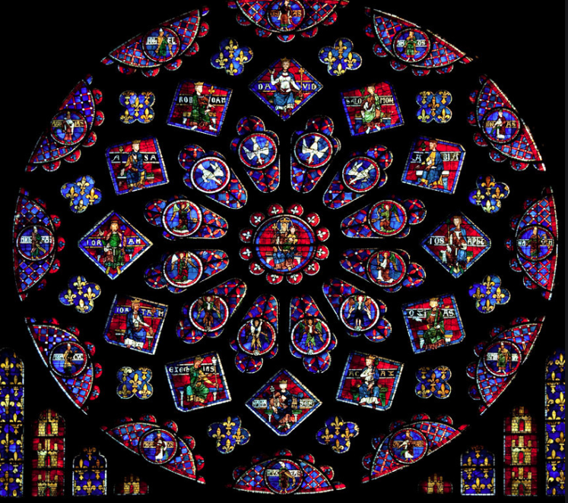
Chartres north transept rose of the Typological Glorification of the Virgin

Slide 11
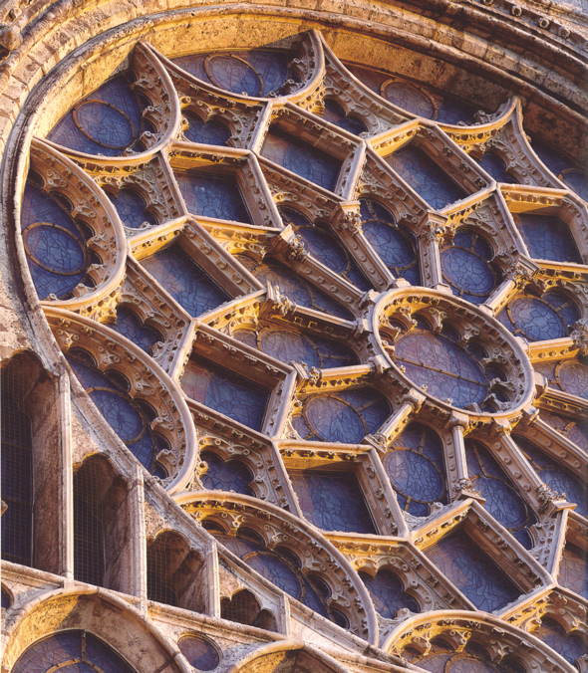
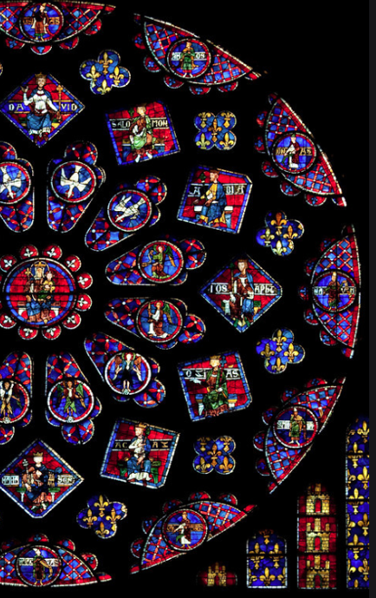
Detail of the interior and exterior of the bar tracery of the north transept rose of c. 1235

Slide 12
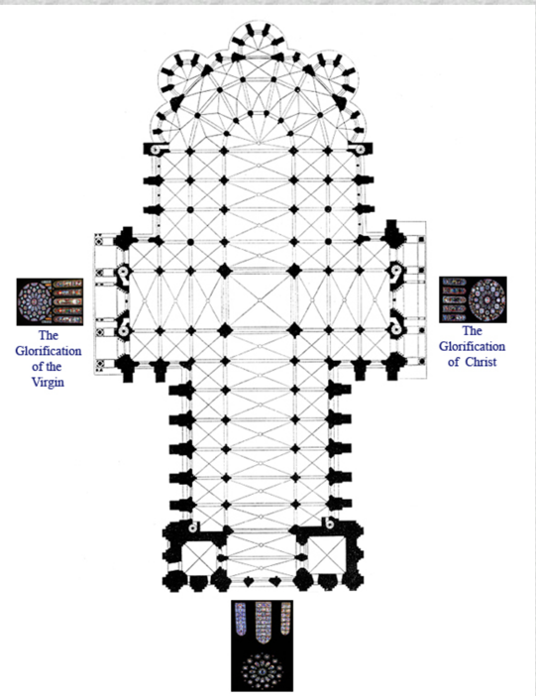
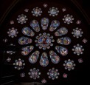
choir
Typological Glory of the Virgin, c. 1235
Glorification of Christ, c. 1230
Last Judgement, c. 1205

